Slide 1

BASICS OF HEMODYNAMICS

Slide 2
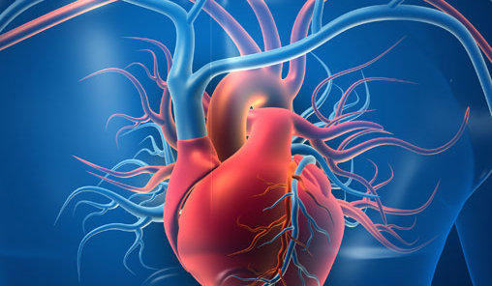
HEMODYNAMICS
Hemodynamics is the study of blood flow and the forces involved in circulation within the cardiovascular system. It involves understanding how the heart pumps blood, how blood vessels regulate flow, and the factors that affect these processes.

Slide 3
Blood Flow
The volume of blood moving through a vessel per unit of time (usually measured in liters per minute or mL/min)
Formula: Blood flow is influenced by pressure differences and resistance (Poiseuille’s law): Q=ΔP/R
Q = Blood flow
ΔP= Pressure gradient
R = Resistance

Slide 4
Blood Pressure (BP)
The force exerted by the blood on the walls of blood vessels. It is usually measured at the level of the arteries.
Systolic Pressure: Pressure when the heart contracts (systole) and pumps blood out.
Diastolic Pressure: Pressure when the heart is relaxed (diastole) and filling with blood.
Mean Arterial Pressure (MAP): The average pressure in the arteries during one cardiac cycle. It is calculated as:
MAP=Diastolic Pressure+ (1/3)​(Systolic Pressure−Diastolic Pressure)

Slide 5
Cardiac Output (CO)
The volume of blood the heart pumps per minute. It is a crucial measure of heart performance.
Formula : CO=HR×SV
Where
HR = Heart rate
SV = Stroke volume

Slide 6
Resistance (R)
The opposition to blood flow, largely determined by the size of the blood vessels, blood viscosity, and vessel length.
Main Factors Influencing Resistance:
Vessel Diameter: Smaller diameter increases resistance
Blood Viscosity: Thicker blood (due to more cells or proteins) increases resistance.
Vessel Length: Longer vessels provide more resistance.

Slide 7
Vascular Compliance (C)
The ability of a blood vessel to expand and contract with changes in pressure. Larger vessels (e.g., veins) tend to be more compliant than smaller ones (e.g., arteries).
Formula:𝐶=Δ𝑉/Δ𝑃
ΔV = Change in blood volume
ΔP = Change in pressure

Slide 8
Systemic Vascular Resistance (SVR)
The resistance offered by the systemic circulation, which can be influenced by the size of the arterioles and the amount of blood flowing through the system.
​

Slide 9
Factors Affecting Hemodynamics
Autonomic Nervous System: Regulates heart rate, blood pressure, and vessel diameter through sympathetic and parasympathetic fibers.
Hormones: Such as adrenaline, angiotensin II, and antidiuretic hormone (ADH) which can regulate blood pressure and volume.
Arterial Compliance: Age and conditions like atherosclerosis reduce compliance, leading to higher systolic pressures.
Body Position: Lying down vs. standing alters blood pressure and blood flow distribution​

Slide 10
Arterial vs Venous Hemodynamics
Arteries: Carry oxygenated blood from the heart to tissues. They have higher pressure and lower volume than veins.
Veins: Return deoxygenated blood to the heart. They have lower pressure but higher capacity to hold blood.

Slide 11
Application in Clinical Practice
Hypertension: Elevated blood pressure that can strain the heart and blood vessels.
Heart Failure: A condition where the heart cannot pump sufficient blood to meet the body's needs, affecting cardiac output.
Shock: A life-threatening condition involving inadequate blood flow to tissues, often due to low cardiac output or severe vasodilation.

